Slide 1
Secure Coding

Slide 2

Presentation Objectives
Provide guidance for software developers
Provide basic concepts for improving software security
Highlight the major coding mistakes that lead to insecure software
Present the case for secure design

Slide 3

Topics
Definitions
Cost of security
Good security practices
Security approach
Security Pitfalls
Buffer overruns
Summary
References

Slide 4

Definitions
Secure products
Products that protects the confidentiality, integrity, and availability of information
Security vulnerability
A flaw in a product that makes it infeasible (even when using the product properly) to prevent an attacker from (1) compromising data, (2) assuming ungranted trust, or (3) seizing control of the user’s system
Threat
Potential event that will have an unwelcome consequence if it becomes an attack

Slide 5
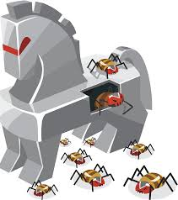
More Definitions
Trojan Horse
Program containing unexpected or hidden functions
Typically damaging
Virus
Program that copies itself and its malicious payload to users
Worm
Program that invades computers on a network typically replicating automatically to prevent deletion

Slide 6

Security Vulnerabilities are Expensive (1)
There is a cost associated with a security vulnerability
Creating a plan
Developers finding and fixing the vulnerable code
Testers testing the fix
Writing the corresponding documentation
Handling bad public relations
Loss of productivity
Working on the fix is time lost for other productivity

Slide 7
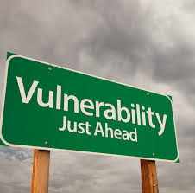
Security Vulnerabilities are Expensive (2)
The cost to your customers to apply the fix
They might need to run the fix on a non-production server to verify that it works as planned
The potential cost of lost revenue, from likely clients deciding to either postpone or cancel using your product or company

Slide 8
Cost of Security Vulnerabilities
$$$ Spent
While it is difficult to determine the exact cost of issuing a single security fix, the Microsoft Security Response Center believes a security bug that requires a security bulletin costs in the neighborhood of $100,000
Availability
The Robert T Morris worm almost brought the entire down in 1998

Slide 9

Why Security is Not Built into Software
Security
Is boring
Something that gets in the way
Difficult to measure
Can affect performance
Not the primary skill or interest of designers or developers creating the product

Slide 10
Never Depend on Security Through Obscurity
Always assume that an attacker knows everything that you know
Assume the attacker has access to all source code and all designs
Even if this is not true, it is easy for an attacker to obtain information
Don’t “hide” passwords on the system
Don’t hide/ignore flaws
Conceal a flaw, and the world will imagine the worst
Marcus Valerius Martialis, Roman poet (C 40 A D –C 104 A D )

Slide 11
Good Security Practices

Slide 12
Learn from Mistakes
How did the security error occur?
Is the same error replicated in other areas of the code?
How could we have prevented this error from occurring?
How do we make sure this kind of error does not happen in the future?
Failure to learn from mistakes increases the probability that you will make the same mistake again
There is only one thing more painful than learning from experience and that is not learning from experience
Archibald McLeish (1892–1982), American poet

Slide 13
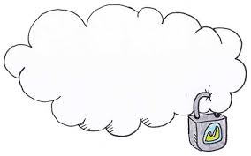
Fail to a Secure Mode
Fail to a secure mode
Failing to a secure mode means that the applications have not disclosed any data that would not be disclosed ordinarily
Data should be protect (cannot be tampered with)
When you fail, do not issue huge swaths of information explaining why the error occurred
Give the user only a little bit of information, enough so that the user knows the request failed
Log the details to some secure log file

Slide 14
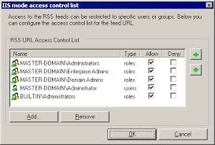
Access Control Lists (ACLs)
Use ACLs
Access control methodology employed by operating systems to determine to what degree an account is allowed to access a resource
Are an incredibly important protection mechanism
Great backstop if the code is exploited

Slide 15

Least Privilege
Employ the Least Privilege Paradigm
All applications should execute with the least privilege to get the job done and no more
Use elevated privileges for the shortest time possible
If a program compromised, least privilege can help limit damage

Slide 16

Least Privilege Example
ILoveYou Virus
Propagates itself using Microsoft Outlook
Writes itself to the system directory and then updates the registry
This virus requires the user be an administrator

Slide 17
Check Function Return Status
Functions should have a return status or an exception handler
Return status should be checked with a corresponding appropriate action
bool errorStatus;
error_status = myFunction();
if (errorStatus != true)
{
// log error
// pass info to error routine
}
Remember Murphy’s Law

Slide 18

Cleanup after Execution
Cleanup after normal and abnormal termination
Delete temporary files
Attackers can obtain access to key information using “residual” files

Slide 19

Plan on User Providing Invalid Data
Assume user will enter too much data
Limit the allowable input
Assume the input data has invalid characters
Handle unexpected invalid characters
Assume user will not follow instructions
Please enter your age: twenty
Don’t allow “Esc”, “Ctrl-C” breaks when inappropriate
Expect and handle data that is “unexpected”
First Name, Middle Initial, Last Name
No middle initial? More than three names?

Slide 20

Plan On Failure
Bugs happen—plan on them occurring
Make security contingency plans
What happens if the firewall is breached?
What happens if the Web site is defaced?
What happens if the application is compromised?
Wrong answer: “It’ll never happen!”
It’s like having an escape plan in case of fire—you hope to never have to put the strategy into practice, but if you do you have a better chance of getting out alive

Slide 21
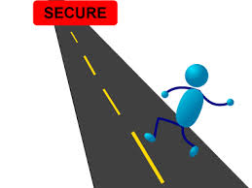
More “Good” Security Practices
Assume external systems are insecure
Consider any data from a system you do not have complete control over to be insecure and a source of attack
Properly train staff to be security aware
Perform threat modeling
One cannot build a secure system until one understands the threats

Slide 22
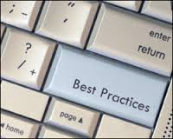
Still More “Good” Security Practices
Security should not be added as an afterthought
Adding security later often requires architectural changes, not just simple code changes or small design changes
It can be difficult to get such changes implemented at later points in the product cycle
Establish a Security Process
Secure systems encompass a security process as well as the product itself
One cannot have a secure product without a security process

Slide 23
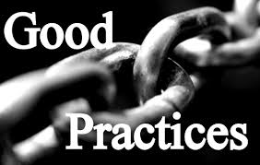
Even “More” Good Security Practices
Use defense in depth
Multiple protections mechanisms (firewalls, intrusion protection, auditing, secure applications, etc )
Employ secure defaults
Consider security as a product feature
Stay abreast of security vulnerabilities
www securityfocus com

Slide 24
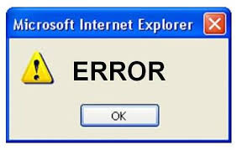
Top 25 Most Dangerous Software Errors
Common Weakness Enumerations (CWEs)
CWE™ International in scope and free for public use
CWE provides a unified, measurable set of software weaknesses that is enabling more effective discussion, description, selection, and use of software security tools and services that can find these weaknesses in source code and operational systems as well as better understanding and management of software weaknesses related to architecture and design
http://cwe.mitre.org/index.html

Slide 25
Perform Threat Modeling - STRIDE
Spoofing – Allows an attacker to pose as another user
Tamper with data
Malicious modification of data – including system data such as access control list (ACL)
Repudiation – associated with users who deny performing an action without any way to prove otherwise
Information disclosure – exposure of information to individuals who are not supposed to have access to it
Denial of service – attacks deny service to valid users
Elevation of privilege – non privileged users become privileged

Slide 26
Security Approach
In order to understand security in any situation, one has to understand the entire system under consideration as well as each individual component so that one can identify their strengths and weaknesses and design the appropriate solutions – Li Gong, Chief Java Security Architect

Slide 27
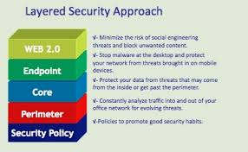
Security Approach
Who is the application’s audience?
What does security mean to the audience?
Where will the application run? On the Internet? Behind a firewall? As an embedded application? On a satellite?
What are you attempting to protect?

Slide 28
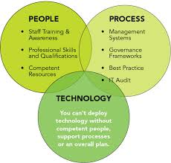
Security Approach
What are the implications to the users if the objects you are protecting are compromised?
What are the communication needs of the product? Is the product internal to the organization or external, or both?
What security infrastructure services do the operating system and the environment already provide that you can leverage?

Slide 29
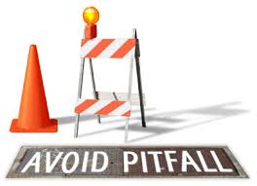
Pitfalls (1)
If we don’t run as administrator, stuff breaks
We operate in a SCIF, why limit what we can do?
No one will do that!
Why would anyone do that?
We’ve never been attacked

Slide 30

Pitfalls (2)
We’re secure—we use cryptography/crypto links
We’re secure—we use Access Control Lists
We’re secure—we use a firewall
We’ve reviewed the code, and there are no security bugs
Everyone on the project has a security clearance

Slide 31
Most Common Problems
Buffer overruns

Slide 32
Types of Overruns
Static Buffer Overruns
Heap Overruns
Boundary Checking Errors
Caused by bad coding practices
Can be prevent by writing solid code
Assume overruns are exploitable!!!!!
Caused by bad coding practices
Can be prevent by writing solid code
Assume overruns are exploitable!!!!!

Slide 33
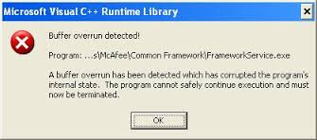
Static Buffer Overruns
Function calls in C/C++
All variables and the caller’s return address are put on the “stack”
Problems can occur when unchecked user input is passed to a function (such as strcpy)
Result: The return address can be overwritten by another address chosen by the attacker

Slide 34
Stack Overrun
#include <iostream>
using namespace std;
int main (void)
{
char inputLastName[80];
char outputLastName[9];
cout << "Please enter the first eight characters of your last name: " << endl;
cin >> inputLastName;
strcpy (outputLastName,inputLastName); // memory can be overwritten
cout << outputLastName << endl;
return 0;
}
Output
Please enter the first eight characters of your last name:
12345678aa
12345678aa
// aa is an address could be used as the return address for exploitation

Slide 35
Stack Not Overwritten
// stack overflow prevented
#include <iostream>
using namespace std;
int main (void)
{
char inputLastName[80];
char outputLastName[9];
cout << "Please enter the first eight characters of your last name: " << endl;
cin >> inputLastName;
strncpy (outputLastName,inputLastName,8); // only eight character are copied
outputLastName[8]='\0';
cout << outputLastName << endl;
return 0;
}
Output
Please enter the first eight characters of your last name:
12345678aa
12345678

Slide 36
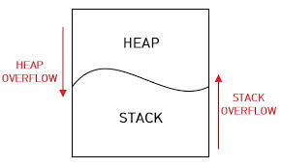
Heap Overrun
Dynamic memory is obtained from the “heap” by using the new operator
Memory is released by using the delete operator
A pointer (address) to the memory retrieved is returned to the calling program
An attacker can write arbitrary information into these dynamic areas of an application
Can be used to overwrite filenames, passwords, etc.
Need to be careful using the above operators

Slide 37
Dynamic Memory
#include <iostream.h>
#include <string.h>
void main (void)
{
char* charArray;
int* numberOfCells ;
cout << "An array will be created dynamically" << endl;
numberOfCells = new int;
cout << "Please enter number larger than 15 " << endl;
cin >> *numberOfCells;
charArray = new char[*numberOfCells];
strcpy (charArray, "This is a test");
cout << "Number of memory locations allocated was " << *numberOfCells << endl;
cout << charArray << endl;
delete numberOfCells;
delete [ ] charArray;
// memory was released but still accessed....
cout << "Number of memory location allocated was " << *numberOfCells << endl;
cout << charArray << endl;
}

Slide 38
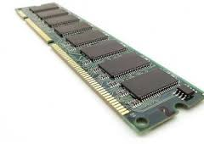
Dynamic Memory Output
An array will be created dynamically
Please enter number larger than 15
16
Number of memory locations allocated was 16
This is a test
Number of memory locations allocated was 1333100
Œ}

Slide 39

Boundary Checking Errors
C/C++ does not normally perform boundary checking

Slide 40
Boundary Checking Problem
// illustrates no boundary checking
#include <iostream>
using namespace std;
int main (void)
{
int intArray[3];
int index;
for (index=0;index <= 3;index++) // what’s the problem?
{
cout << "Please enter an integer: ";
cin >> intArray[index];
cout << "The integer just entered was " << intArray[index] << endl; ;
}
return 0;
}

Slide 41
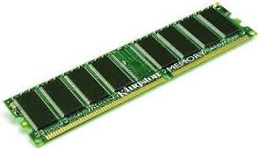
Memory Overwritten Output
Please enter an integer: 1
The integer just entered was 1
Please enter an integer: 2
The integer just entered was 2
Please enter an integer: 3
The integer just entered was 3
Please enter an integer: 4
The integer just entered was 4

Slide 42
Memory Not Overwritten
// illustrates boundary checking
#include <iostream>
using namespace std;
int main (void)
{
int intArray[3];
int index;
for (index=0;index < 3;index++) // corrected
{
cout << "Please enter an integer: ";
cin >> intArray[index];
cout << "The integer just entered was " << intArray[index] << endl; ;
}
return 0;
}

Slide 43
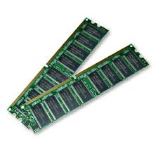
Memory Overwritten Output
Please enter an integer: 1
The integer just entered was 1
Please enter an integer: 2
The integer just entered was 2
Please enter an integer: 3
The integer just entered was 3

Slide 44

Additional Boundary Checking
// Illustrates the string class boundary checking
#include <iostream>
#include <string>
using namespace std;
void main( void )
{
string myString="Isn't this fun";
myString[15]='s'; // overwrites memory
cout << myString[15] << endl;
// myString.at(15)='t'; // will cause program to error
// cout << myString.at(15) << endl;
}
Output
s

Slide 45

Another Common Overrun Problem
Use of the gets() function
Reads input until a carriage return is encountered
An attacker can easily overrun buffers

Slide 46
gets() Problem
#include <iostream>
using namespace std;
int main (void)
{
char myString[80] ;
cout << "Please enter a character string: ";
gets(myString); // gets( ) problem
cout << "The character string just entered was " <<
myString << endl; ;
return 0;
}
output
Please enter a character string: the rain in Spain fall mainly in the plain
and the cow jumped over the moon and the string entered is too long
The character string just entered was the rain in Spain fall mainly in the plain
and the cow jumped over the moon and the string entered is too long

Slide 47

Summary
Security should be designed at the beginning
Assume the user will try to break it
Fail to a secure state
Avoid buffer overflows
Perform error checking
Clean up after yourself

Slide 48
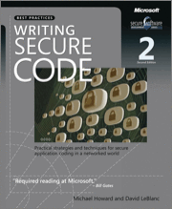
Secure Coding Reference
Never assume that an application will be run in only a few given environments
Chances are good it will be used in some other, as yet undefined, setting
Assume instead that the code will run in the most hostile of environments, and design, write, and test the code accordingly
Writing Secure Code, Howard & LeBlanc
Second Edition - ISBN 0-7356-1588-8

Slide 49
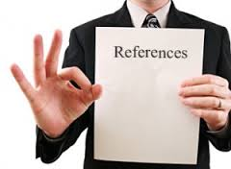
Additional Book References
Practical UNIX & Internet Security (2nd ed)
Garfinkel, Spafford – ISBN 1-56592-148-8
Managing Information Security Risks: The OCTAVE Approach
Alberts and Dorofee – ISBN 0-321-11886-3

Slide 50

Cyber Security Certifications
Certified Information Systems Security Professional (CISSP)
Provides information security professionals with an objective measurement of competence as well as a globally recognized standard of achievement
Information Systems Security Engineering Professional (ISSEP)
Guide for incorporating security into projects, applications, business processes, and all information systems

Slide 51

Web References
http://www auscert org au
Excellent Collection of technical information
http://rr sans org
SANS Technical reading library
http://www/cert/org
Source for security practices information
http://csrc nist gov
Computer Security Resource Center
http://www cert org/security-improvement/#unix
List of security topics to choose from

